Slide 1
2015 AmCham Internship Program
American Chamber of Commerce in Montenegro
March 17, 2015

Slide 2
2015 AmCham Internship Program
Three month internship with one of AmCham’s member companies including AmCham Montenegro;
Program runs April 14 - July 14, 2015;
21 available positions;
10 participating companies/organizations;

Slide 3
Minimum criteria:
Students must be in the final year of studie;
Must have an 8.0 Grade Point Average, or above, on a 10.0 scale, or equivalent on another grade scale;
Possess excellent knowledge of the English language;
Strong computer skills;
Motivation, creativity and entrepreneurial spirit;

Slide 4
Application materials:
CV (in English);
Certificate verifying regular enrollment in the final year of studies;
Certificate with an overview of all examinations and with average score achieved in previous years of study;
Cover letter (in English);

Slide 5

For more information about the AmCham Internship Program, please visit:
Website
http://www.amcham.me/amcham-news/aip2015/
Facebook
facebook.com/amchammontenegro
Twitter
twitter.com/AmChamMNE

Slide 6
Participating Companies

Slide 7

Telenor Crna Gora is one of leading mobile providers in Montenegro.
Telenor is Norway’s largest telecommunications company and one of the fastest growing providers of mobile communications services worldwide.
Candidate background: Faculty of Economics
Number of available positions: 1

Slide 8

Crnogorski Telekom provides all telecommunication services - fixed telephony services, broadcast, mobile, data, Internet and international communication.
Crnogorski Telekom is majority owned by Magyar Telekom.
Candidate background: Faculty of Electrical Engineering or Faculty of Polytechnics and Faculty of Economics
Number of available positions: 2;1;

Slide 9

Telemont is a leader in the Montenegrin market in the segment of telephone systems and their maintenance.
Telemont provides its clients with the best possible telecommunication solutions and local technical support.
Candidate background: Faculty of Electrical Engineering (Electronics, IT/Communications and Automatics);
Number of available positions: 3

Slide 10

Deloitte Touche Tohmatsu Limited, commonly referred to as Deloitte, is one of the "Big Four" professional services firms.
Founded in 1845 with global headquarter located in the United States. Deloitte provides audit, tax, consulting, enterprise risk and financial advisory services with more than 200,000 professionals in over 150 countries.
Candidate background: Faculty of Economics
Number of available positions: 2

Slide 11

ČIKOM is the company for engineering and IT consulting founded in 1993. in Montenegro.
Čikom provides its users with the widest range of goods and services in the field of information and communication technologies.
Candidate backgorund: Faculty of Electrical Engineering or Faculty for Information Technology
Number of available positions: 1

Slide 12

Gintasmont is one of the youngest member of Gintas Group. The main task is construction and contracting.
With the synergy of GİNTAŞ experience, Gintasmont is working for improving life starts of Montenegrin people.
Candidate background: Faculty of Economics (Marketing) and Faculty of Electrical Engineering
Number of available positions: 1; 1;

Slide 13

Lustica Development was founded in 2008.
A joint initiative between Orascom Development Holding (90%) and the Government of Montenegro (10%), it aims to create a community which will best serve the country’s cultural and economic interests through intelligent development of the land using sustainable and environmentally sound methods.
Candidate background: Faculty of Economics and Faculty of Electrical Engineering (Arhitecture) or Faculty of Polytechnics
Number of available positions: 1; 1;

Slide 14


Mediterranean University is a university located in Podgorica, Montenegro, founded on 30 May 2006.
Meditettanean University is the first private university established in Montenegro and is organized in 6 faculties: Faculty of Tourism, Hotel and Trade Management Bar, Faculty of Business Studies, Montenegro Business School, Faculty of Visual Arts and Faculty of Information Technology.
Candidate background: Faculty of Economics (Marketing) and Law Faculty
Number of available positions: 1; 1;

Slide 15

Societe Generale Group is one of the largest European groups to provide financial services.
Societe Generale Montenegro bank provides a full range of banking services to citizens and businesses.
Candidate background: Faculty of Economics, Faculty of Sciences (Mathematics) or Faculty of Polytechnics and Law Faculty
Number of available positions: 2; 1; 1;

Slide 16
AmCham Montenegro is an independent business association consisting of 70 member companies. AmCham Montenegro is comprised of American-based companies as well as some of the most prominent local and international companies operating in Montenegro.
Established in 2008, AmCham Montenegro is dedicated to improving the business environment of Montenegro in order to attract more U.S. and other foreign investments.
Candidate background: Law Faculty or Faculty of Economics
Number of available positions: 1

Slide 17
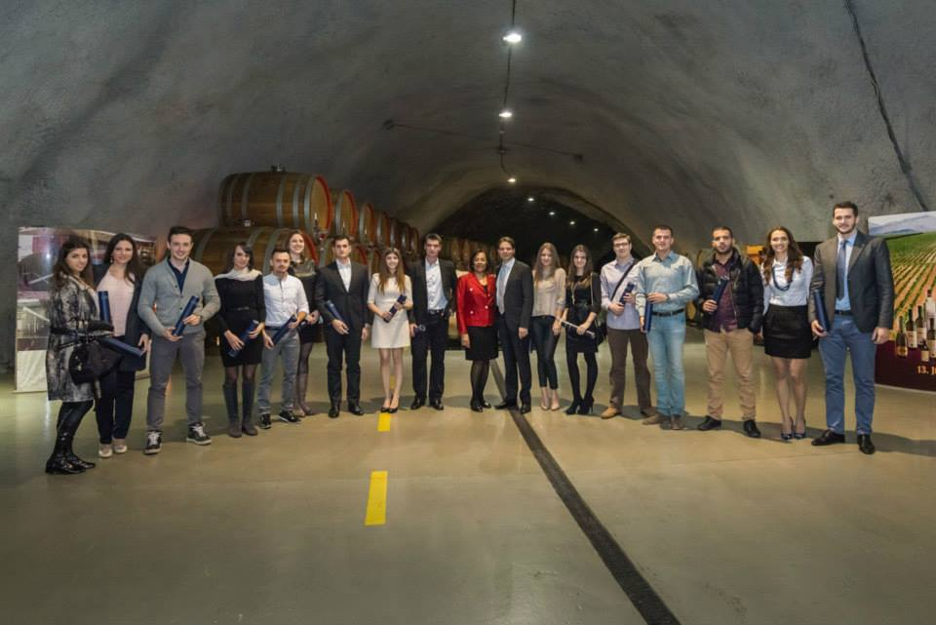
2014 AmCham Internship Program
Certificate Ceremony

Slide 18
Thank You !

